Slide 1
Презентация
Светлана Федорук, Дунаева Арина
8 класс
МБОУ Часцовская СОШ
п. Часцы
Учитель: Татьяна Александровна Ветрюк

Slide 2
«Robinson Сrusoe»
вy Daniel Defoe
the main characters: Robinson Crusoe, Friday, Xury
publicistic style
He does not give up. He does not lose heart.
It is hard for me not to admire this person.
genre: adventure novel

Slide 3
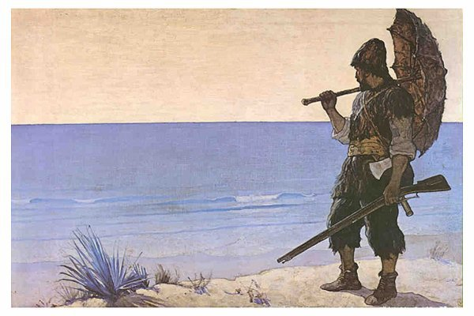
“It is never too late to be wise”
“Thus fear of danger is ten thousand times more terrifying than danger itself.”
“Those people cannot enjoy comfortably what God has given them because they see and covet what He has not given them. All of our discontents for what we want appear to me to spring from want of thankfulness for what we have.”
“Redemption from sin is greater then redemption from affliction.”

